Slide 1

NITROGEN GENERATORS

Slide 2
BASICS ABOUT AMBIENT AIR

Slide 3
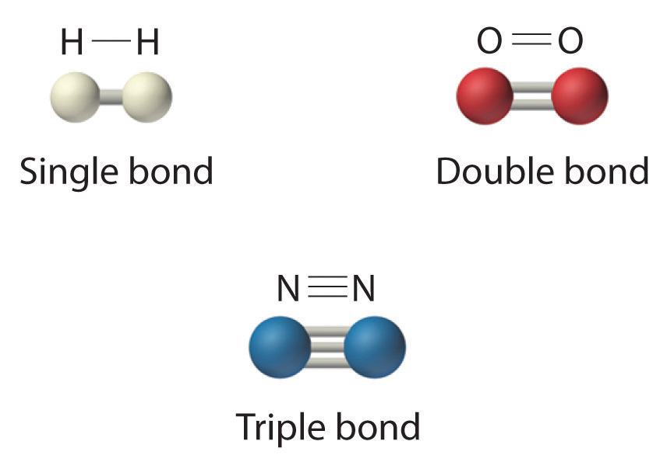
BASICS ABOUT NITROGEN AND OXYGEN
NITROGEN
OXYGEN
N₂
O₂
INERT
COLORLESS, ODORLESS AND TASTELESS GAS
DOES NOT ENTER IN CHEMICAL REACTIONS
DOES NOT SUPPORT COMBUSTION
REACTIVE
COLORLESS, ODORLESS AND TASTELESS GAS
REACTS WITH MOST OF THE CHEMICAL ELEMENTS
NECESSARY FOR MOST LIVING ORGANISMS AND FOR METABOLIC PROCESSES

Slide 4

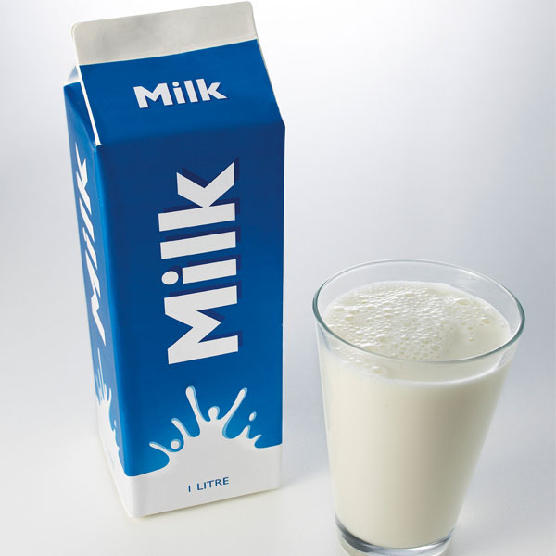


NITROGEN APPLICATIONS
INERTING AND BLANKETING
PURITY: 99 – 99,9 %
WINE
OILS (Olive oil, soybean oil, …)
SOFT DRINKS (Juice, mineral water, …)
DAIRY PRODUCTS
  (Milk, powdered milk, cheese, butter, …)
  SOFT DRINKS (Juice, mineral water, …)
TO REDUCE / PREVENT PRODUCT DEGRADATION FROM MOISTURE AND OXYGEN

Slide 5



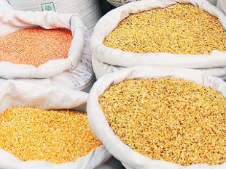
NITROGEN APPLICATIONS
CONTROLLED ATMOSPHERE STORAGE
PURITY: 95 – 99,99 %
FOOD PRODUCTS
FRUITS
VEGETABLES
TO PRESERVE FRESH FRUITS AND VEGETABLES

Slide 6
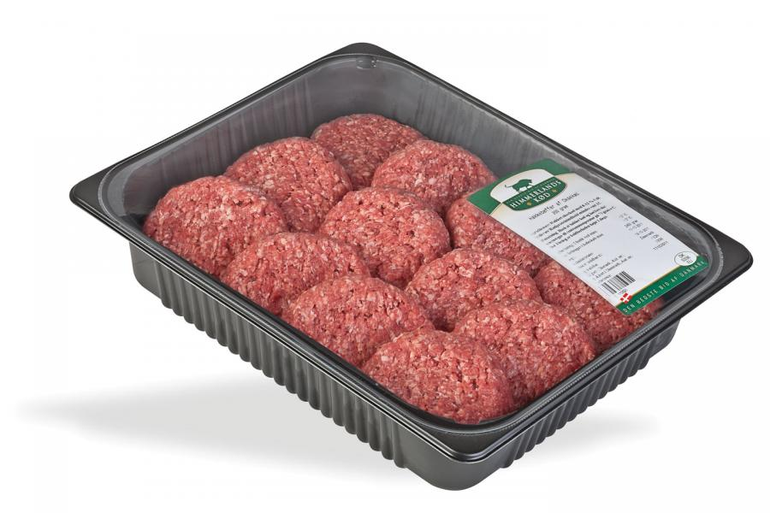
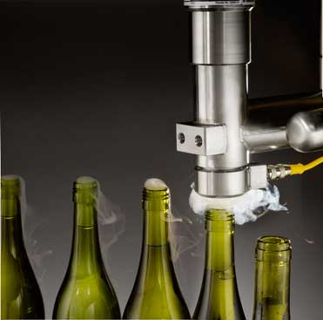

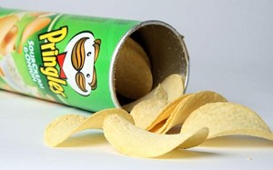
NITROGEN APPLICATIONS
MODIFIED ATMOSPHERE PACKAGING (MAP)
PURITY: 95 – 99,5 %
MEAT PRODUCTS
PRE-COOKED FOOD
WINE
DAIRY PRODUCTS
PHARMACEUTICAL PRODUCTS
TO EXTEND SHELF LIFE

Slide 7


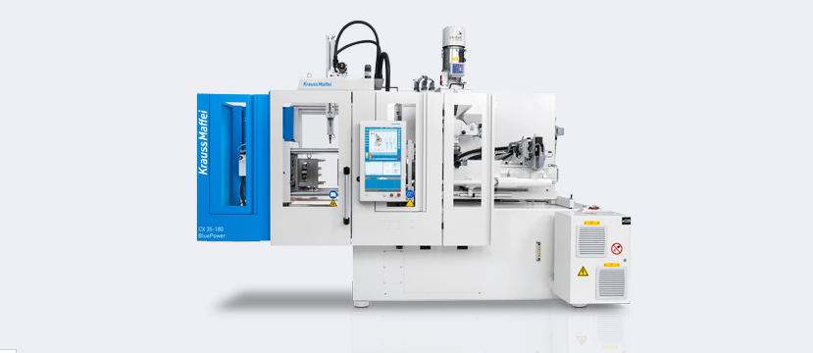

NITROGEN APPLICATIONS
INDUSTRIAL APPLICATIONS
PURITY: 95 – 99,9999 %
LASER CUTTING
ELECTRONICS
GAS INJECTION MOULDING
PROTECTIVE ATMOSPHERE IN EXPLOSIVE AREA
TO ASSURE STABLE QUALITY / TO IMPROVE PROCESS QUALITY / SAFETY

Slide 8
APPLICATIONS PROCESS REQUIREMENTS
Application | Purity as % of O2 | Pressure of N2 (barg) | Specific Requirements
Food procesing -MAP - Wine Sparging Control atmosphere Meat packing | 2- 0,5 | Low | Sterile Filtration
Blanketing | 2-5 | Low
Gas Injection Molding | 0,5-1 | High | Booster
Electronics | 0,1 – 0,01 | Low
Lasser cutting | 0,0001 | 30 or 250 | Booster

Slide 9
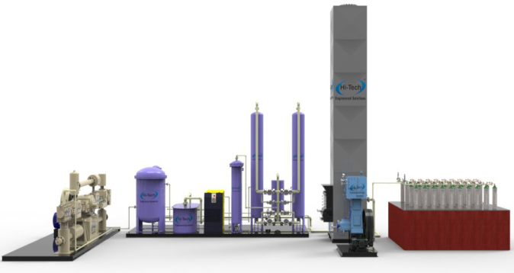
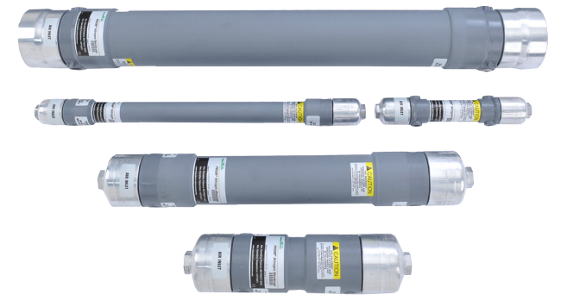
NITROGEN PRODUCTION METHODS
MEMBRANE
PRESSURE SWING ADSORPTION PSA
CRYOGENIC PLANT
LOW-MEDIUM PURITY (90 TO 99,5%)
LOW CAPACITY (UP TO 1000M3/H)
LOW INVESTMENT
MEDIUM PRODUCTION PRICE
LOW-HIGH PURITY (90 TO 99,5%)
MEDIUM CAPACITY (< 10.000M3/H)
MEDIUM INVESTMENT
MEDIUM PRODUCTION PRICE
MEDIUM-HIGH PURITY (to 99,9999%)
HIGH CAPACITY ( > 10.000M3/H)
HIGH INVESTMENT
LOW PRODUCTION PRICE

Slide 10
NITROGEN PRODUCTION METHODS
99,9999
99,999
LIQUID NITROGEN
CYLINDER
PSA
99,99
Nitrogen purity [%]
CRYOGENIC NITROGEN PLANT
99,9
99
MEMBRANE
90
1
10
100
1000
10000
100000
Nitrogen consumption [Nm3/h]

Slide 11
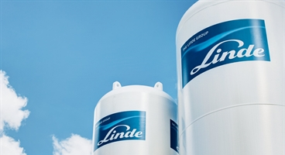
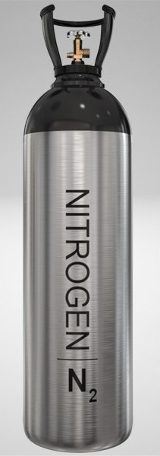
WHY GENERATE YOUR OWN N2 / O2 RATHER THAN USING LIN?
PSA GENERATOR
CONTRACT SUPPLY

Slide 12
WHY GENERATE YOUR OWN GAS RATHER THAN USING CONTRACT SUPPLY?
✓
Safety reason
Simple and Ready on demand
Total control over production
Production capacity fit your needs
No icing of the liquid gas tanks
No losses of the gass due to evaporation
Lower costs
No contractual limitations
✓
✓
✓
✓
✓
✓
✓

Slide 13
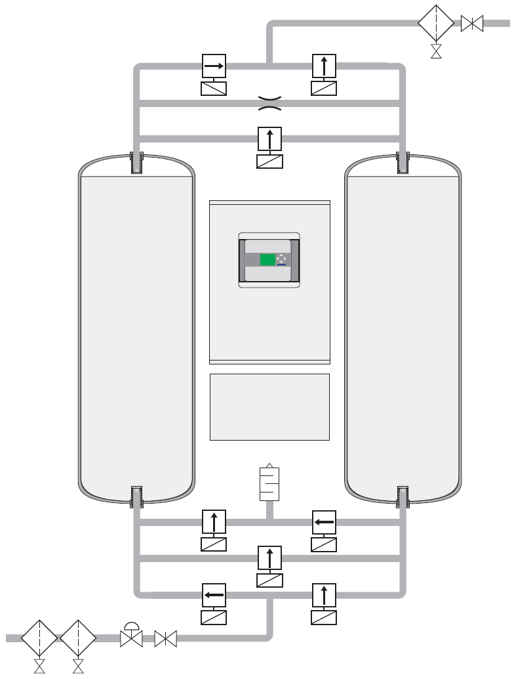

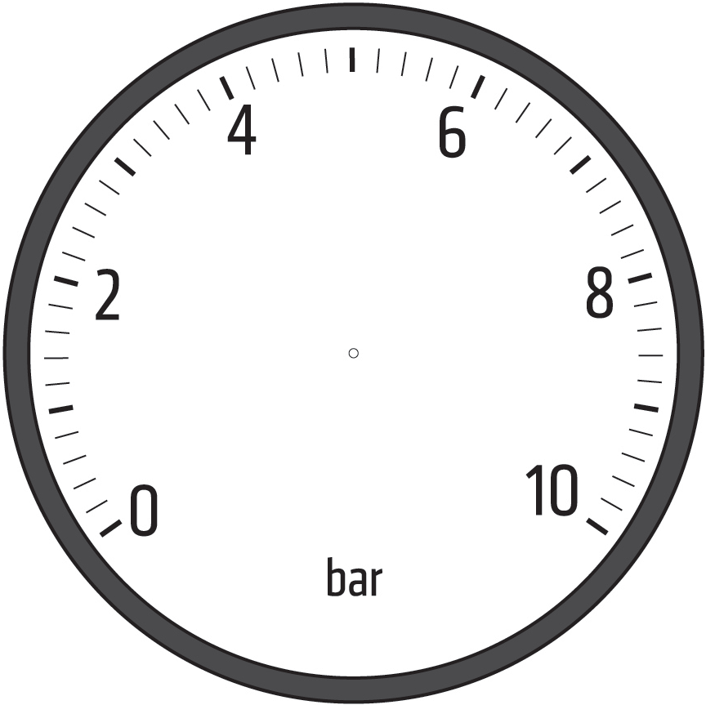

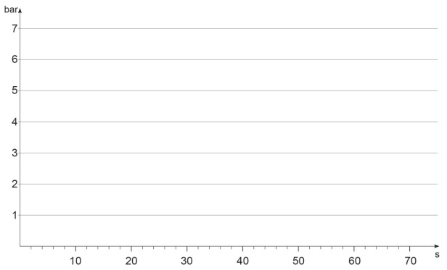

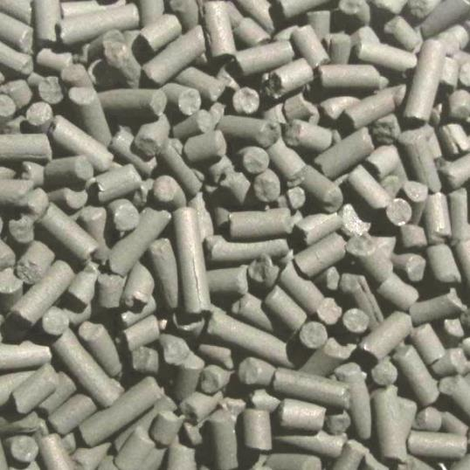
HOW PSA GAS GENERATOR WORKS
N₂
Pressure
building phase
Adsorption
Regeneration
N₂
N₂
N₂
N₂
O₂
O₂
t
O₂
O₂
Compressed air
O₂

Slide 14

HOW PSA NITROGEN GENERATOR WORKS
N₂
Depressurization
Pressure
equalization
phase
Pressure
building phase
Adsorption
Regeneration
t

Slide 15
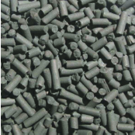
ADSORPTION MECHANISM OF CMS

Slide 16
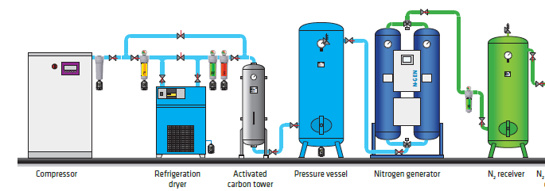
COMPRESSOR STATION WITH PSA GENERATOR
COMPRESSOR
OIL LUBRICATED / OIL FREE
AIR TREATMENT
Class 1.4.1. acc. To ISO 8573-¸1
AIR BUFFER
TANK
GENERATOR
NITROGEN BUFFER TANK

Slide 17
BUFFER TANKS
COMPRESSED AIR CONSUMPTION
NITROGEN CONSUMPTION
STEADY
Consumption
Consumption
Time
Time
PERIODIC
Consumption
Time

Slide 18
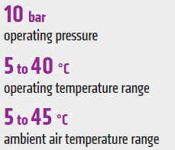
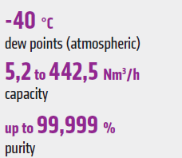
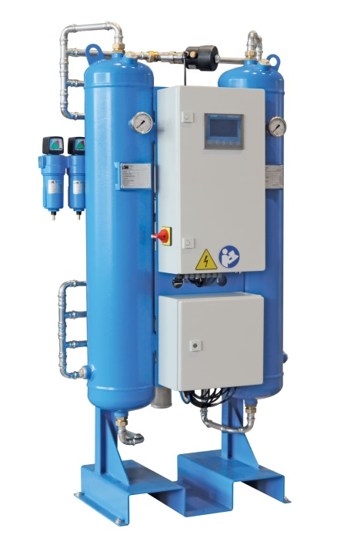
N-GEN SERIES NITROGEN GENERATOR
STANDARD EQUIPMENT
• SET OF EXTERNAL FEED AIR FILTERS
• ADSORBER VESSELS
• PNEUMATIC VALVES
• INTERNAL PIPING & FITTINGS
• MAINTENANCE-FREE EXHAUST SILENCERS
• AIR AND NITROGEN PRESSURE REGULATION
• LOCAL INSTRUMENTATION
• CONTROL SYSTEM WITH SIMENS LOGO
• PRESSURE SWITCH FOR AUTOMATED STAND-BY MODE

Slide 19
N-GEN SERIES NITROGEN GENERATOR
OPTIONAL EQUIPMENT
• OXYGEN ANALYSER WITH ZIRCONIUM-OXIDE SENSOR
• ELECTRONIC PRODUCT FLOW METER
• FEED AIR / PRODUCT MOISTURE ANALYSER
• FEED AIR / PRODUCT TEMPERATURE TRANSMITTERS
• NITROGEN STERILE FILTERS
• NITROGEN BOOSTER
• NITROGEN CYLINDER FILLING SYSTEM
• TOUCH SCREEN DISPLAY

Slide 20
N-GEN SIZES
Model | INLET PRESSURE [barg] | DISCHARGE PRESSURE [barg] | NITROGEN PURITY [vol. %]
 |  |  | 97 | 98 | 99 | 99,5 | 99,9 | 99,99 | 99,999
N GEN 05; N2 flow [Nm3/h] | 7,5 | 6,6 | 9,0 | 7,4 | 6,2 | 5,2 | 3,4 | 1,7 | 1,1
Feed air consumption [Nm3/h] |  |  | 23,2 | 21,0 | 19,7 | 18,0 | 14,5 | 10,5 | 9,5
N GEN 10; N2 flow [Nm3/h] | 7,5 | 6,6 | 15,2 | 12,4 | 10,5 | 8,7 | 5,8 | 2,9 | 1,8
Feed air consumption [Nm3/h] |  |  | 38,9 | 35,3 | 33,0 | 30,2 | 24,3 | 17,6 | 15,9
N GEN 15; N2 flow [Nm3/h] | 7,5 | 6,6 | 24,1 | 19,7 | 16,7 | 13,8 | 9,2 | 4,6 | 2,8
Feed air consumption [Nm3/h] |  |  | 61,8 | 56,1 | 52,5 | 48,0 | 38,6 | 28,0 | 25,3
N GEN 20; N2 flow [Nm3/h] | 7,5 | 6,6 | 30,2 | 24,6 | 20,9 | 17,3 | 11,5 | 5,7 | 3,5
Feed air consumption [Nm3/h] |  |  | 77,3 | 70,3 | 65,6 | 60,1 | 48,3 | 35,1 | 31,6
N GEN 25; N2 flow [Nm3/h] | 7,5 | 6,6 | 42,7 | 34,8 | 29,5 | 24,5 | 16,2 | 8,1 | 4,9
Feed air consumption [Nm3/h] |  |  | 109,4 | 99,4 | 92,8 | 85,0 | 68,4 | 49,6 | 44,7
N GEN 35; N2 flow [Nm3/h] | 7,5 | 6,6 | 67,4 | 55,0 | 46,6 | 38,6 | 25,6 | 12,8 | 7,9
Feed air consumption [Nm3/h] |  |  | 172,7 | 156,9 | 146,6 | 134,2 | 107,9 | 78,3 | 70,6
N GEN 60; N2 flow [Nm3/h] | 7,5 | 6,6 | 111,9 | 91,4 | 77,4 | 64,2 | 42,6 | 21,2 | 13,1
Feed air consumption [Nm3/h] |  |  | 286,9 | 260,6 | 243,5 | 223,0 | 179,3 | 130,1 | 117,3
N GEN 100; N2 flow [Nm3/h] | 7,5 | 6,6 | 192,9 | 157,5 | 133,5 | 110,6 | 73,4 | 36,6 | 22,5
Feed air consumption [Nm3/h] |  |  | 494,5 | 449,3 | 419,7 | 384,4 | 309,1 | 224,3 | 202,2
N GEN 200; N2 flow [Nm3/h] | 7,5 | 6,6 | 354,3 | 289,2 | 245,0 | 203,1 | 134,8 | 67,2 | 41,3
Feed air consumption [Nm3/h] |  |  | 907,9 | 824,8 | 770,6 | 705,8 | 567,5 | 411,8 | 371,3
N GEN 300; N2 flow [Nm3/h] | 7,5 | 6,6 | 590,9 | 482,4 | 408,7 | 338,8 | 224,8 | 112,0 | 68,9
Feed air consumption [Nm3/h] |  |  | 1514,3 | 1375,8 | 1285,3 | 1177,2 | 946,5 | 686,9 | 619,3
N GEN 400; N2 flow [Nm3/h] | 7,5 | 6,6 | 771,8 | 630,0 | 533,8 | 442,5 | 293,6 | 146,3 | 90,0
Feed air consumption [Nm3/h] |  |  | 1977,9 | 1797,0 | 1678,8 | 1537,6 | 1236,3 | 897,1 | 808,9

Slide 21
CERTIFICATES
STANDARD
PED 2014/68/EU Pressure equipment directive (vessels are calculated for dynamic load)
2014/30/EU Electromagnetic compatibility
2014/35/EU Low voltage directive
OPTIONAL
ASME sec. VIII div.1
BV Marine, DNV, ABS, GL, …
ISO 13485
MDD

Slide 22
CASE STUDY
PSA
CONTRACT SUPPLY
Nitrogen production 3.0 (99,9 %)
Investment value
Compressor KSA 22; 3,21m3/min, 10 bar
Refrigeration dryer OMD 175
Pressure vessel TP500V13
Pressure vessel TP300V
Filtration AF 0186
Condensate drain ECD 40B
Activated carbon tower TAC 250
Nitrogen generator N-GEN 50
Total investment | 25.362 EUR
Simple depreciation at 8 years | 3.170 EUR
Variable costs
Energy costs - compressor KSA 22 | 220 kWh/day
Daily energy costs | 33 EUR/day
Annual service costs | 3.000 EUR
Total variable costs (energy+service)/year | 10 260 EUR
TOTAL ANNUAL COSTS | 13.430 EUR
Costs / 1 Nm3 | 0,13 EUR/Nm3
Costs / 1 Nm3 | cca 0,4-0,7 EUR/Nm3
Annual costs | 13.000 EUR
Annual nitrogen costs | 40.000 EUR

Slide 23
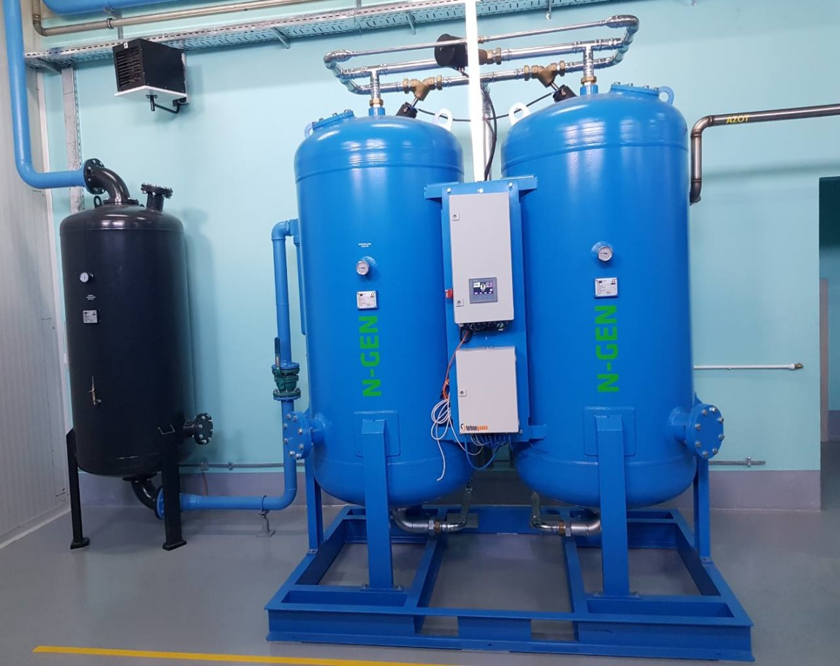
CASE STUDY – GRAND KAFA
APPLICATION: TO PRESERVE AROMAS
AND SHELF LIFE OF THE COFFEE
NITROGEN PRODUCTION: 264 m3/h
PURITY: 99,9 %
COMPRESSED AIR
CONSUMPTION: 850 m3/h
Case study:
Grand Prom d.o.o.
Nitrogen production plant
Case study:
Grand Prom d.o.o.
Water cooling process

Slide 24
THANK YOU FOR YOUR ATTENTION
OMEGA AIR d.o.o. Ljubljana
Cesta Dolomitskega odreda 10
SI-1000 Ljubljana, Slovenia
Tel.: +386 (0)1 200 68 00
Fax.: +386 (0)1 200 68 50
E-mail: info@omega-air.si
www.omega-air.si

